Slide 1
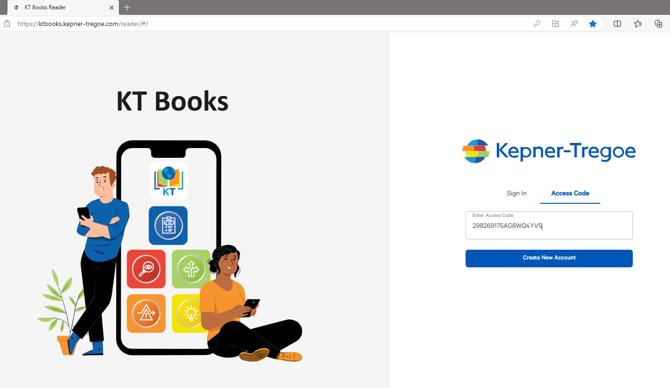
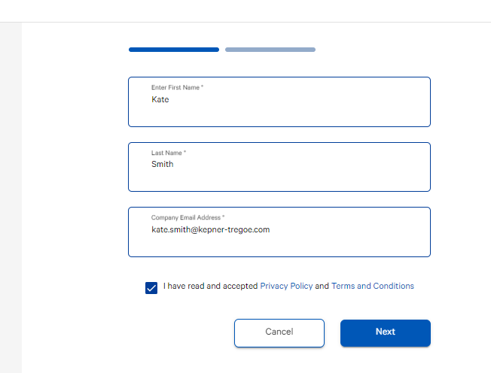
Digital Materials – Welcome to KT Books
Go to https://ktbooks.kepner-tregoe.com
Click Access Code
Enter your access code and click Create New Account
Follow the prompts to create your account
NOTE: You must register with your Company Email address;
Personal email addresses are prohibited
KT Books Video

Slide 2
KT Books FAQ
How long can I access my books on the KT Books platform?
Once you open a book, you will have access to all books on your shelf for 90 days. You will have the option to print (to paper or PDF) each book once during the 90-day period. Both will have a watermark identifying the user and stating that reproduction or distribution is prohibited. Which will allow you to still reference your materials after your account access has expired.
Can I print my books?
Yes. You will have the option to print (to paper or PDF) each book once during the 90-day period. Both will have a watermark identifying the user and stating that reproduction or distribution is prohibited. Which will allow you to still reference your materials after your account access has expired.
Will my notes and highlights that I made in the book be printed?
No, any notes or highlights you make in the book will be not printed in the paper or PDF copy. If you want to retain your notes we suggest you make them in another program such as Word or print a paper copy of materials to write/highlight on.

