Slide 1
KT Books
Please locate the welcome email sent to you the end of last week:
‘Hello from KT Books’ ktbooks@kepner-tregoe.com
If you do not see the email - check your SPAM/Junk folder
Follow the steps to create your account
DO NOT USE INTERNET EXPLORER
DO NOT USE BROWSER ZOOM CONTROLS
(Keep browser zoom at 100%)

Slide 3
KT Books FAQ
Do I need to enter an Activation Code on my shelf?
No, the materials you need for the workshop are already on your e-bookshelf!
Can I print the materials from KT Books?
No, there is not the ability to print from KT Books.
Can I download the materials locally on my computer (example – download as a PDF)?
While you can’t download the materials to your hard drive, you can download them to your browser cache and to your Apple or Android device to view offline.
If I make notes in my KT Books app, will I see those changes in my web viewer via my computer?
Yes, notes made in the app and web viewer sync with one another.
Notes:
Here are some FAQs to review with the learners. These are the most common questions we receive about the materials.

Slide 4
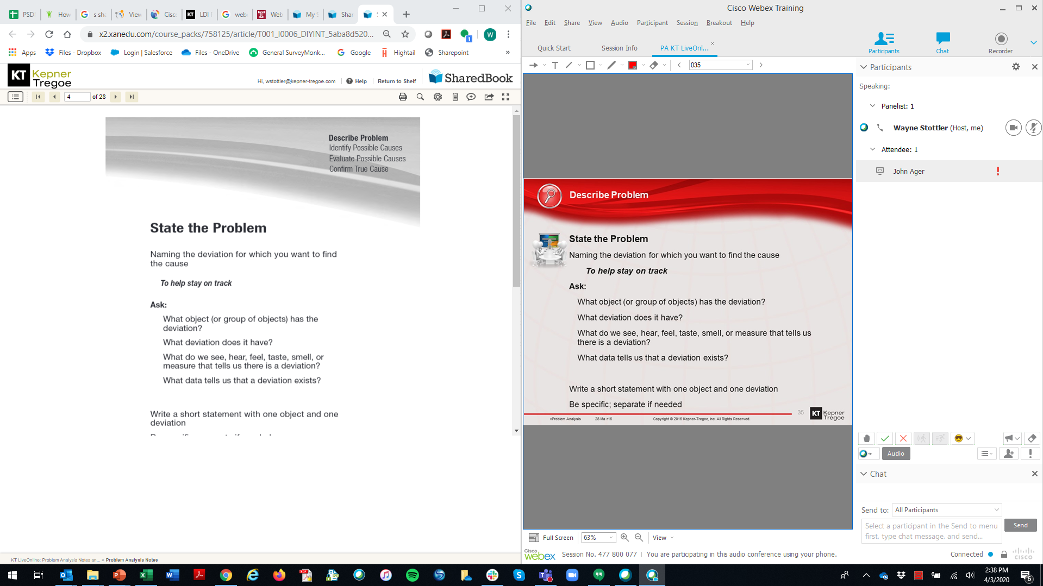
Consider side by side WebEx and KT Books in Main & Breakout Room
Notes:
Lastly, if the learners don’t have a ‘second screen’ such as a monitor or tablet – suggest that they use the materials and breakout room and main room in split screen view. It might be a good idea to show them how to do this live in the session. It is easier to see and learn how than to explain with words.

